Slide 1
HADOOP SETUP AND PROGRAMMING
2. Hadoop Program

Slide 2
Learning Outcomes
Upon completion of this lesson, students will be able to:
Install and setup IDE
Eclipse
Intellij
Create a Hadoop program
Run a simple MapReduce Program

Slide 3
Introduction
So far from previous tutorials, we have a pseudo-distributed cluster running on our machine ,and we know how to run a jar
Next Question is
How to write a map-reduce program?
How to get the jar of the map-reduce program?
We will demonstrate that and explain the WordCount example code.

Slide 4
The Process
We assume that you already have Hadoop on your own machine.
In the following, we will discuss steps in details

Slide 5
Preparing IDE
Hadoop programs are Java programs. You may use any Java IDE such as Eclipse, NetBeans, IntelliJ IDEA to develop your Map-Reduce program.
We are going to use Eclipse/Intellij in this document.
If you have Eclipse/Intellij on your own machine, you can skip this section.

Slide 6
Install Eclipse
To install Eclipse, run this command in shell
sudo apt-get install eclipse

Slide 7
Start Eclipse
Type ‘eclipse’ to start Eclipse

Slide 8
Create Project in Eclipse

Slide 9
Download Intellij
Download intellij community version
https://www.jetbrains.com/idea/download/#section=linux

Slide 10
Start Intellij
Double click on the downloaded tar.gz file, unzip it to a folder
Go to that folder then go to idea-IC-172.4155.36/bin, run ./idea.sh in shell
Remember to install scala plugin if you use Intellij

Slide 11
Start Intellij

Slide 12
Create Project in Intellij
Click on next until done.

Slide 13
Create a JAVA Class
Create a new java class
Copy all the code in WordCount.java into this file

Slide 14
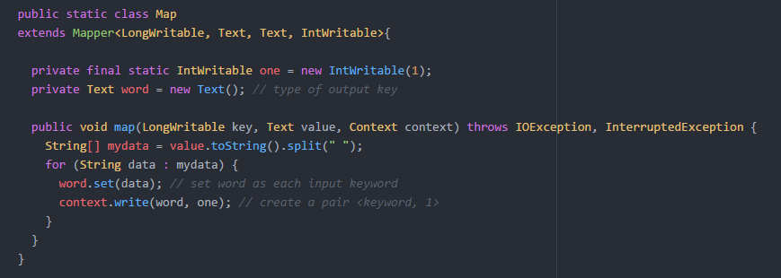
Map code in WordCount.java

Slide 15
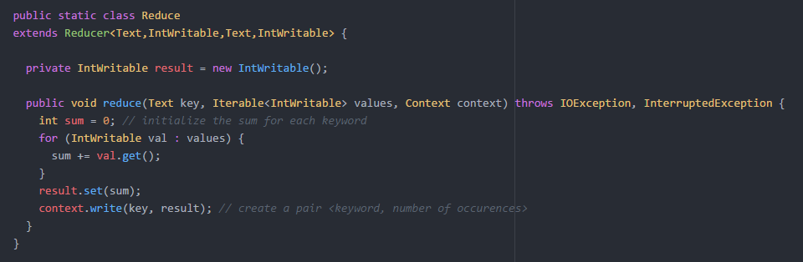
Reduce code in WordCount.java

Slide 16
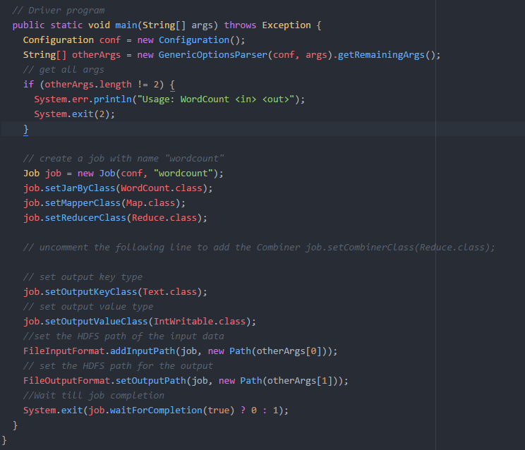
The Driver Setup

Slide 17
Adding Hadoop reference
In order to compile Hadoop projects, you need to add Hadoop library as a reference to your projects.

Slide 18
Adding Libraries in Eclipse
Right-click on the project. Select “Build Path” -> “Configure Build Paths”, select “Libraries” tab. Click on “Add External JARs…” to continue.
Go to your Hadoop installation path.
Find “hadoop-mapreduce-client-core-2.8.1.jar” in /share/hadoop/mapreduce folder, and add it.
Click on “Add External JARs…”again.
Find “hadoop-common-2.8.1.jar” in /share/hadoop/common folder, and add it.
You need also add “commons-cli-1.2.jar” in the folder /share/hadoop/common/lib folder.

Slide 19
Adding Libraries in Eclipse

Slide 20
Adding Libraries in Eclipse

Slide 21
Adding Libraries in Eclipse
Your build path configuration should be similar to this screen now:
Note the version number should be based on previous instructions

Slide 22
Adding Libraries in Intellij
Click on File -> Project Structure -> Module
On the larger right pane, choose the Dependencies tab
Click on “+” and choose ”Jars or directories”
Add all those jars mentioned above
Click on OK to save and exit

Slide 23
Adding Libraries in Intellij

Slide 24
Adding Libraries
Add all the JARS below into build path (both Eclipse and Intellij)
commons-collections-3.2.2.jar
slf4j-api-1.7.25.jar
slf4j-simple-1.7.25.jar
Commons-logging-1.1.3.jar at /share/hadoop/common/lib
Guava-11.0.2.jar at /share/hadoop/tools/lib

Slide 25
Creating the JAR file for Hadoop
All you need to do now is to create the JAR file and run it in Hadoop

Slide 26
Creating the JAR file in Eclipse
Right click on the project, and choose “export”
Then use “Browse” button in front of the “JAR file:” label to specify the name of the export file
For example, you may use (or you can use any other path)
“/home/user/WordCountSample/wordcount.jar”
Now, it should be two files inside WordCountSample folder

Slide 27
Creating the JAR file in Intellij
File -> Project Structure -> Artifacts -> “+” -> Jar -> From modules with dependencies
Then select main class and click on ok.
Next, go to Build -> Build Artifacts -> Build. It is in out/artifacts folder

Slide 28
Creating the JAR file in Intellij

Slide 29
Run in Hadoop
Now lets execute the WordCount program in Hadoop
Run following command in shell:
start-dfs.sh

Slide 30
Upload Input File
Create a file that contains some words (for example, test.txt)
Upload your input file to the input folder of Hadoop with the following command:
hdfs dfs –put <location of file> <location of input directory on hadoop>
For example:
hdfs dfs -put test.txt /user/alan/input

Slide 31
Run JAR file
Run the JAR file with following command:
hadoop jar <Address of the jar> <ClassName> <location of input> <location of output>
For example:
hadoop jar WordCount.jar WordCount /user/alan/input/test.txt /user/alan/out

Slide 32
Check output
Run the following command to download the output
hdfs dfs –get <location of output>
For example:
hdfs dfs –get /user/alan/out
In the out folder just downloaded, you can find part-r-0000, which stores output

Slide 33
Remove Old Output Folders
If you run the program again without deleting the previous output folder, you will get an error
So before running the program, delete output directory if it already exists:
hdfs dfs -rm -r <location of output>

